Slide 1

Protocolli Multidisciplinari nel Fine Vita
Antonio la greca
Fondazione policlinico universitario a. gemelli irccs, roma universita’ cattolica del sacro cuore
Chirurgia d’urgenza e trauma

Slide 2

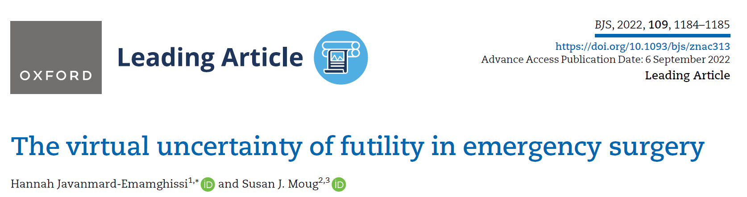
FUTILITY ?
«do not operate a patient the day he’s dying»
A. Leppaniemi, Pisa (Italy) 2023
Futility is when ‘there is a goal, there is an action and activity aimed at achieving this goal and there is virtual certainty that the action will fail in achieving this goal’.
Having been described initially by Hippocrates before his death in 370BC, the importance of futility remains today.

Slide 3
Managing scenarios where you, as the surgeon, believe that a surgery will be futile is challenging.
The first step is to recognize that this is a balance of risk…

Slide 4
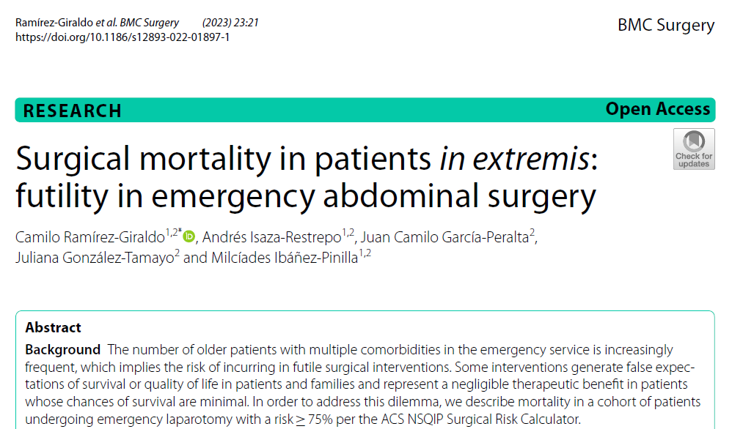
Futility «Quantification»: does it work?

Slide 5
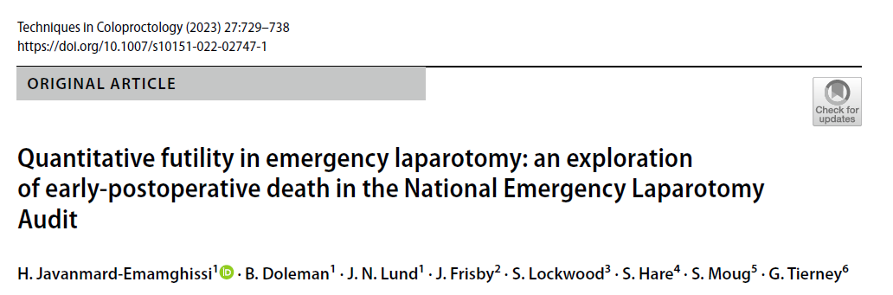
Futility «Quantification»: does it work?
EmSurg futility = early postoperative death within 72 h

Slide 6
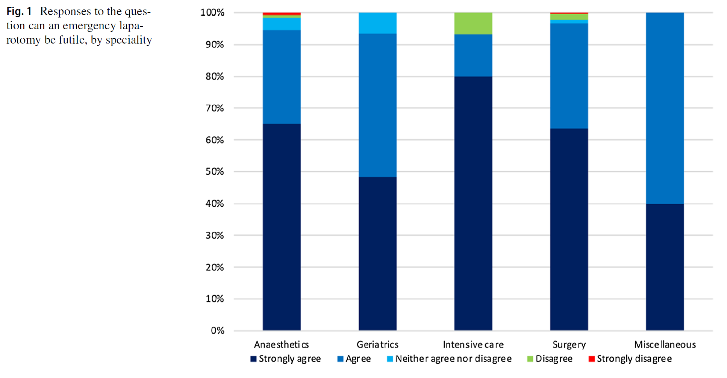
Futility «Quantification»: does it work?
“Only 4% of surgeries result in a quantitatively futile outcome strongly suggesting that appropriate decision-making is part of current emergency surgery practice in the UK”
«The differing responses from different specialties highlight the varying experiences and values that a multidisciplinary team can provide to these high-risk patients. Where a decision to operate or not may not be clear to a single surgeon, a multidisciplinary council assessment including anaesthetics, critical care and, if appropriate, geriatricians should be routinely considered»

Slide 7
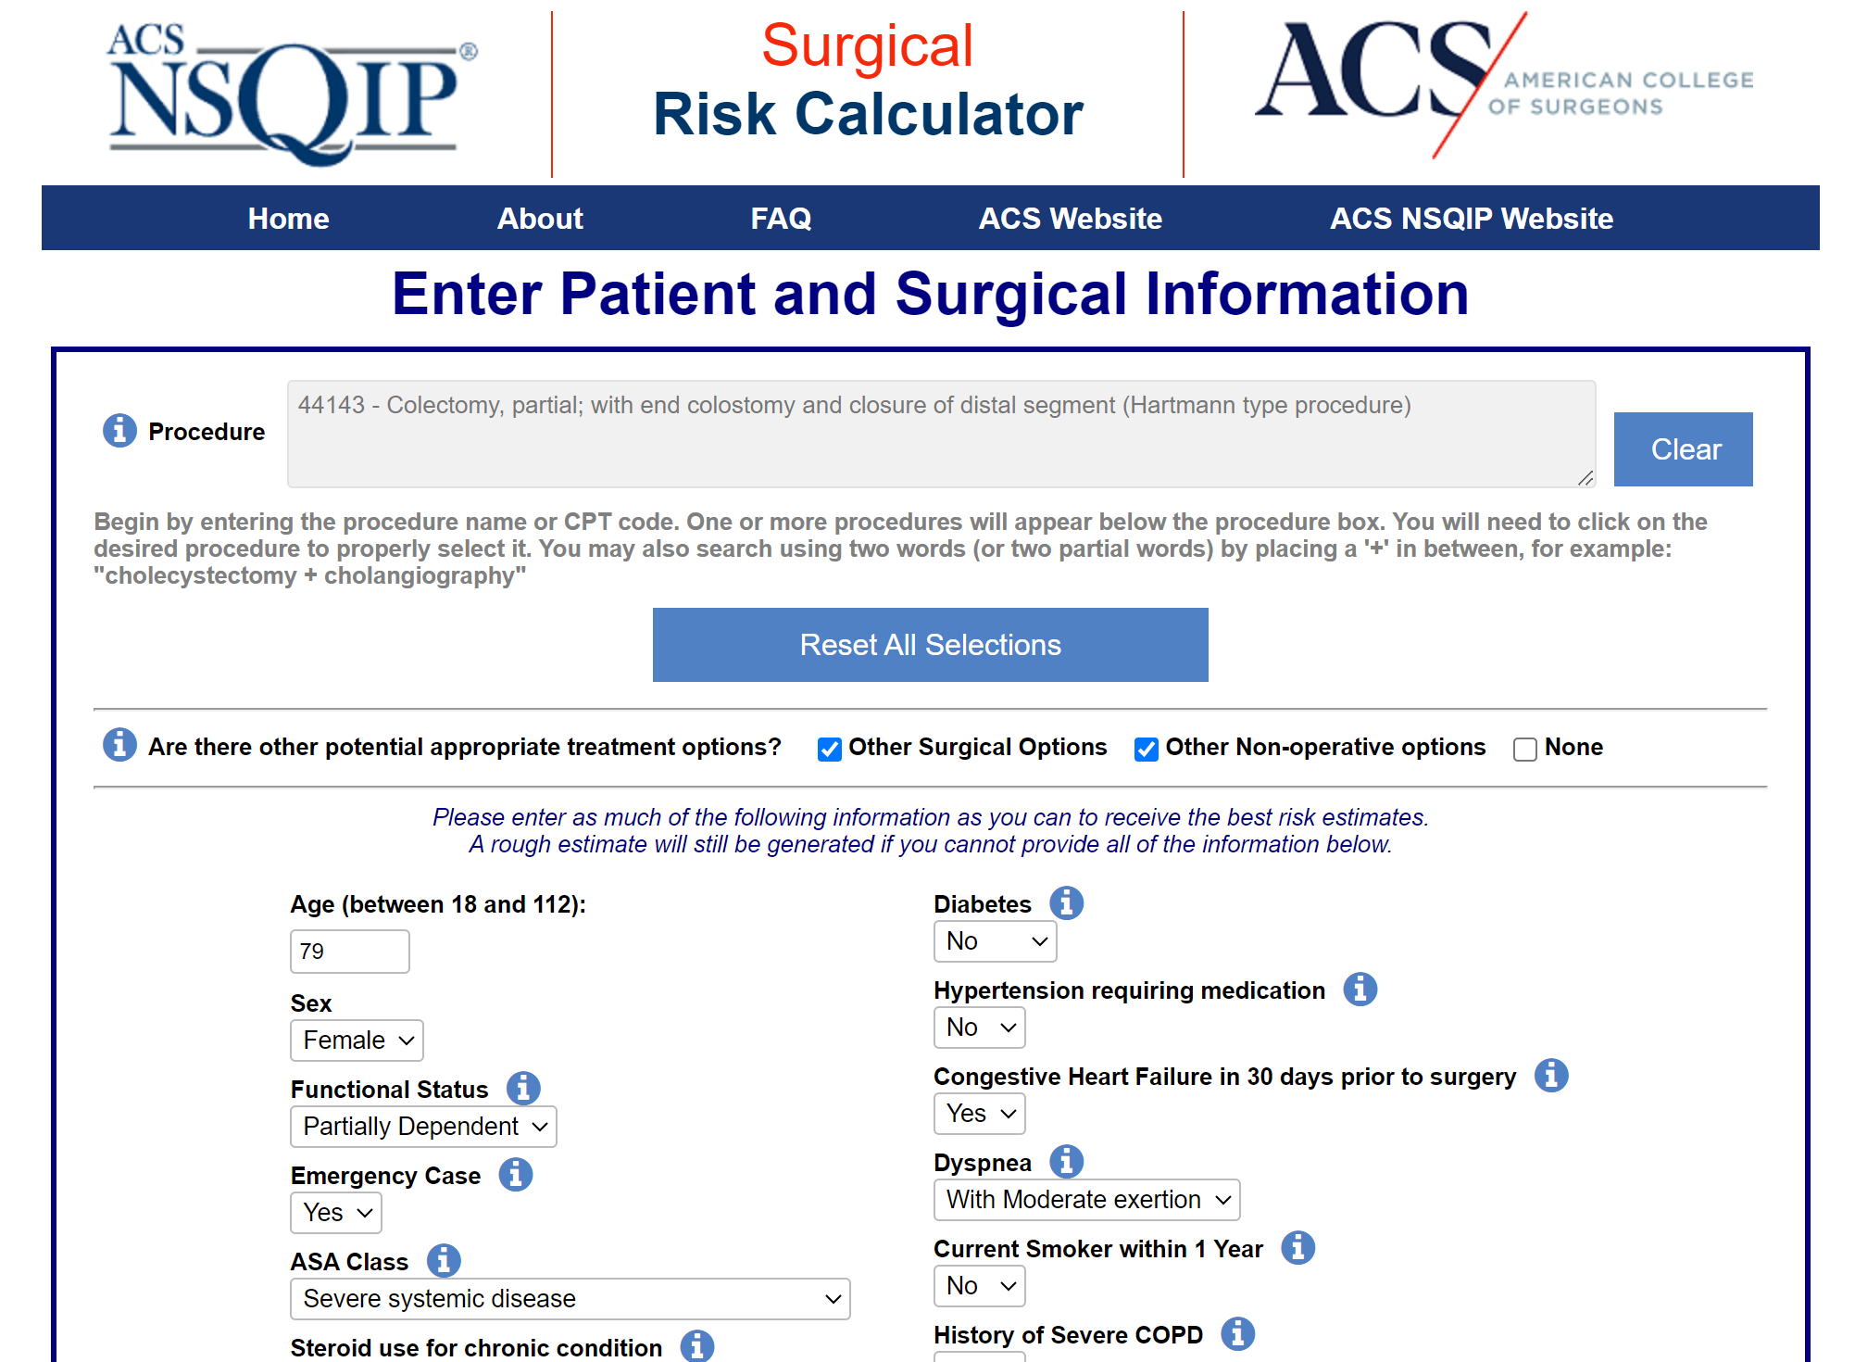
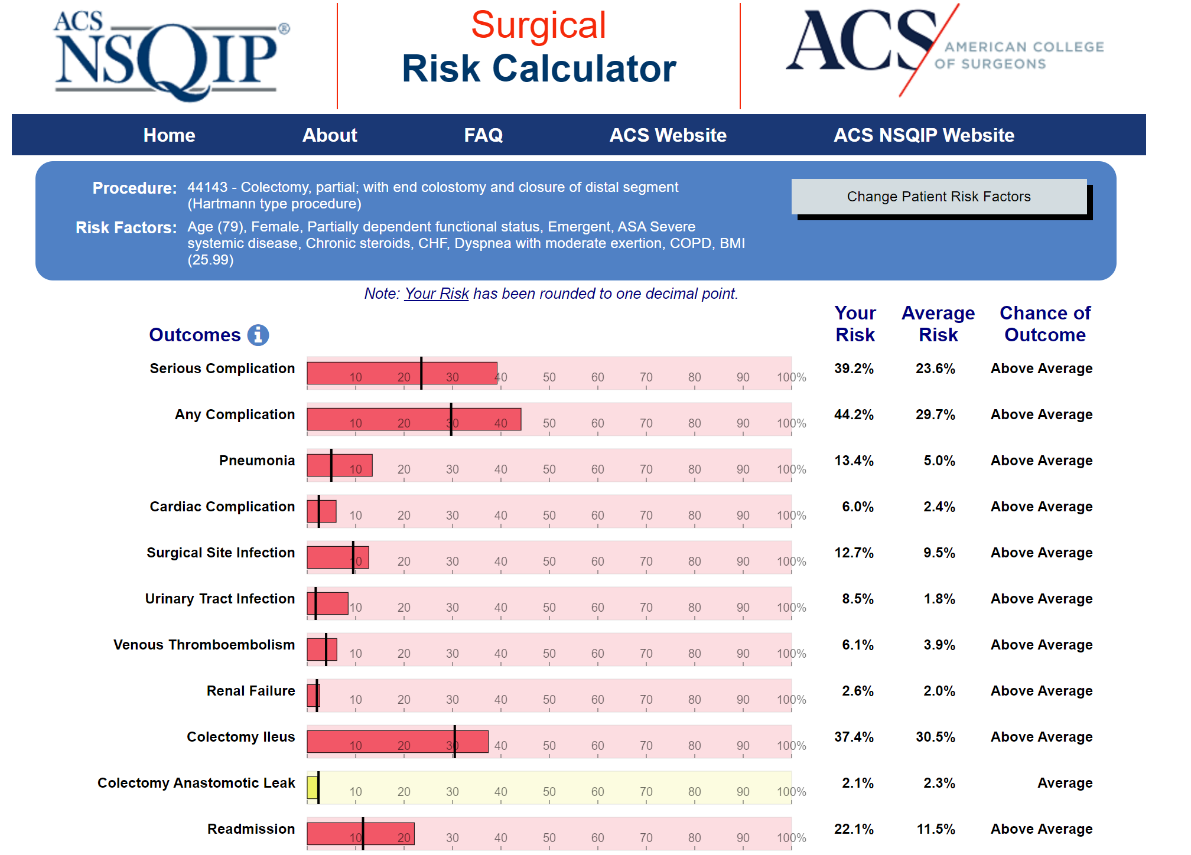
Futility «Quantification»: does it work?

Slide 8
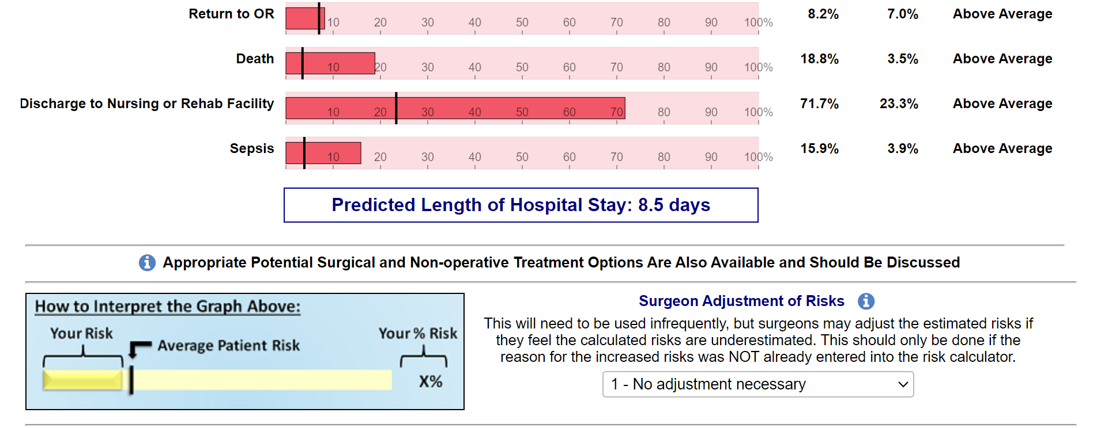
Futility «Quantification»: does it work?

Slide 9
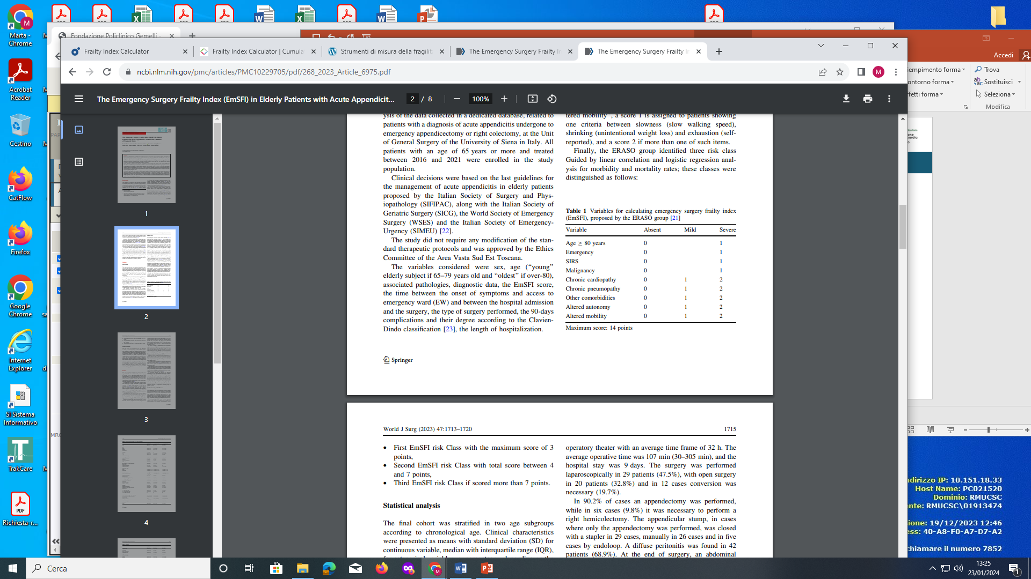
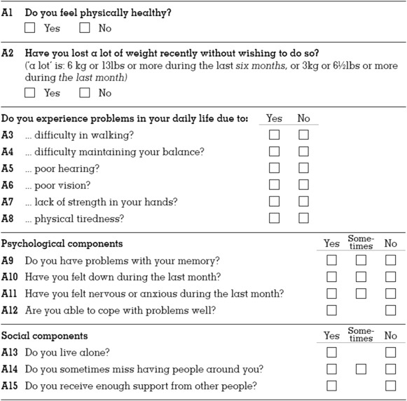
Futility «Quantification»: does it work?
EmSFI = 12 (high risk > 7)
Tilburg frailty index = 8 (cutoff >5)
x
x
x
x
x
x
x
x
x
x
x
x
x
x
x

Slide 10
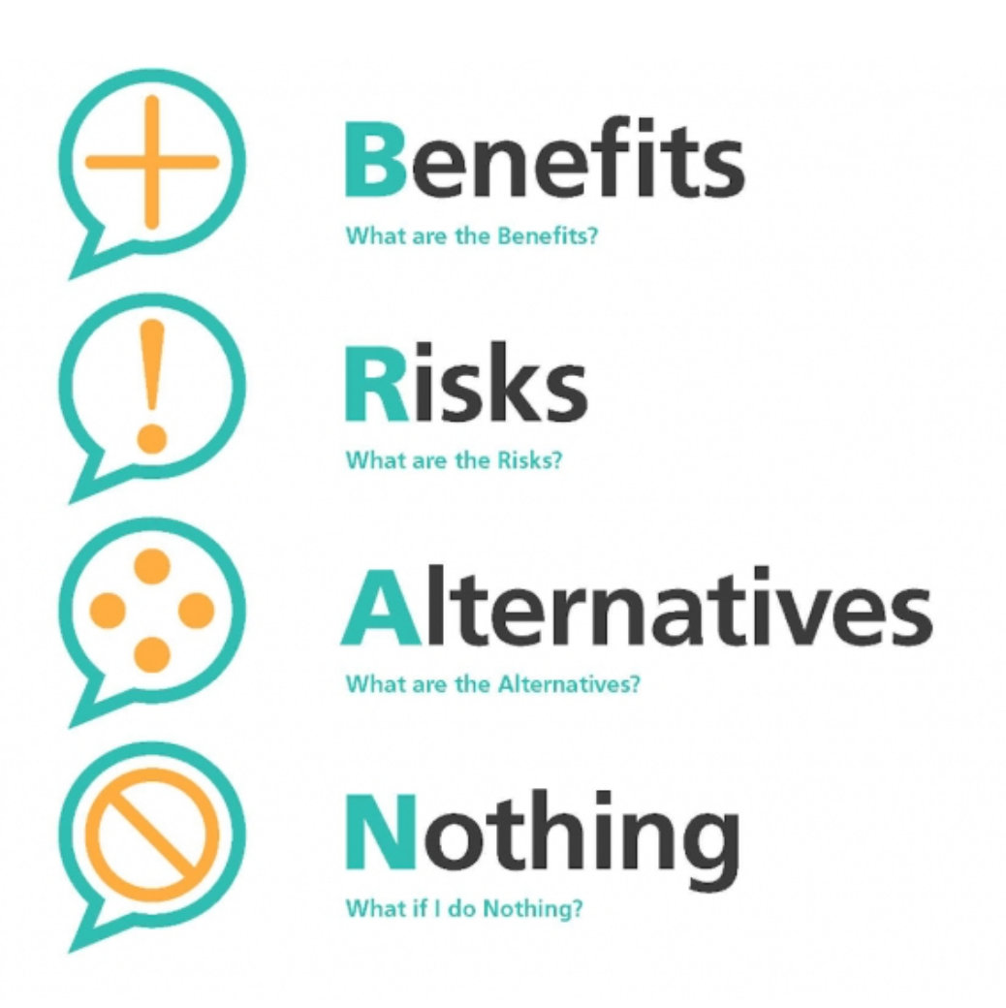
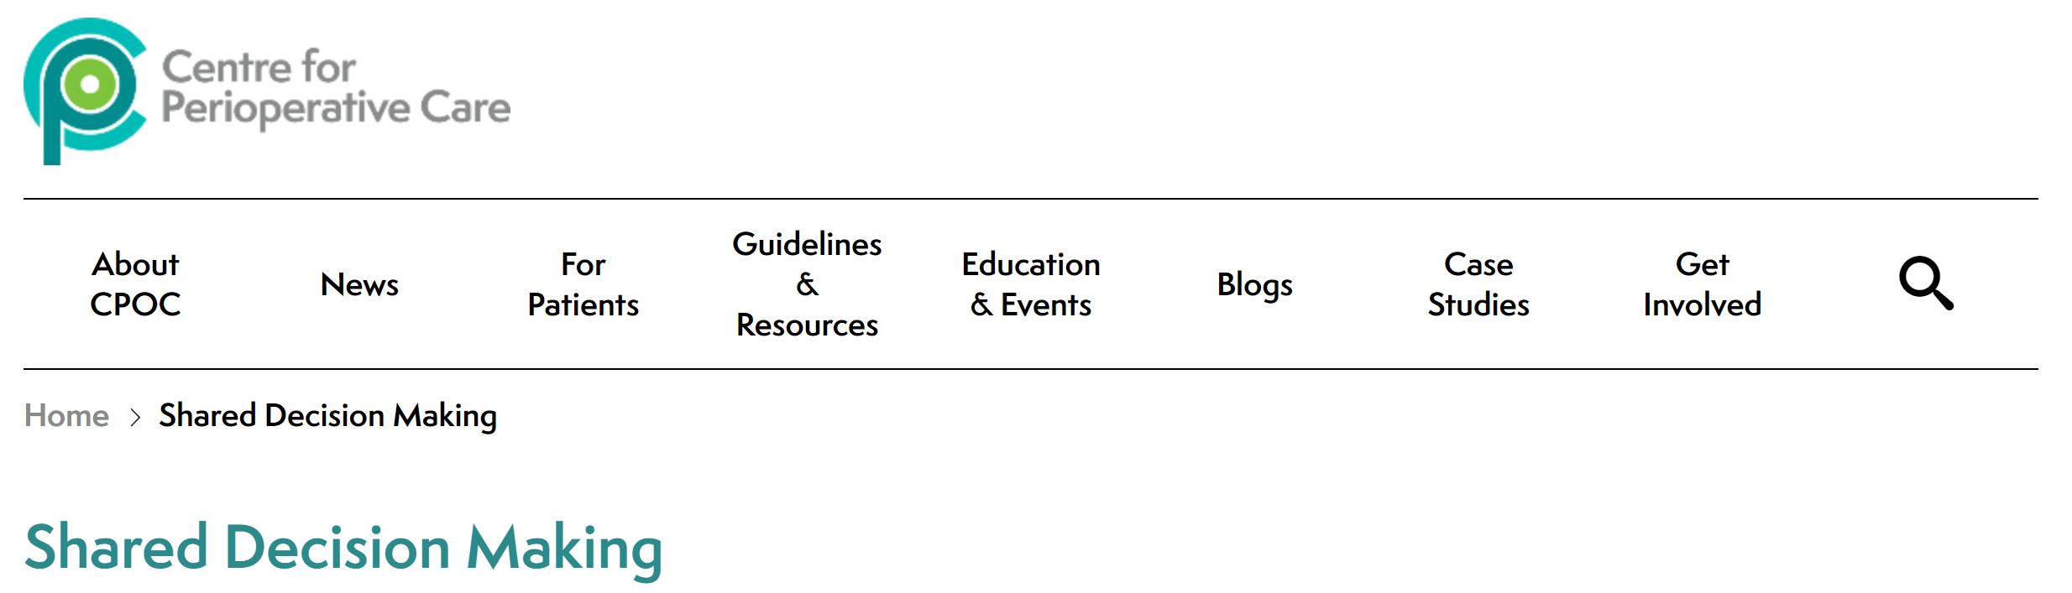
Futility «Quantification»: does it work?
Managing scenarios where you, as the surgeon, believe that a surgery will be futile is challenging. The first step is to recognize that this is a balance of risk …
… and that your experience and perception of risk using objective scores needs to work alongside the patient’s values and their perception of risk according to those values.
B.R.A.N. Decision Making Framework

Slide 11
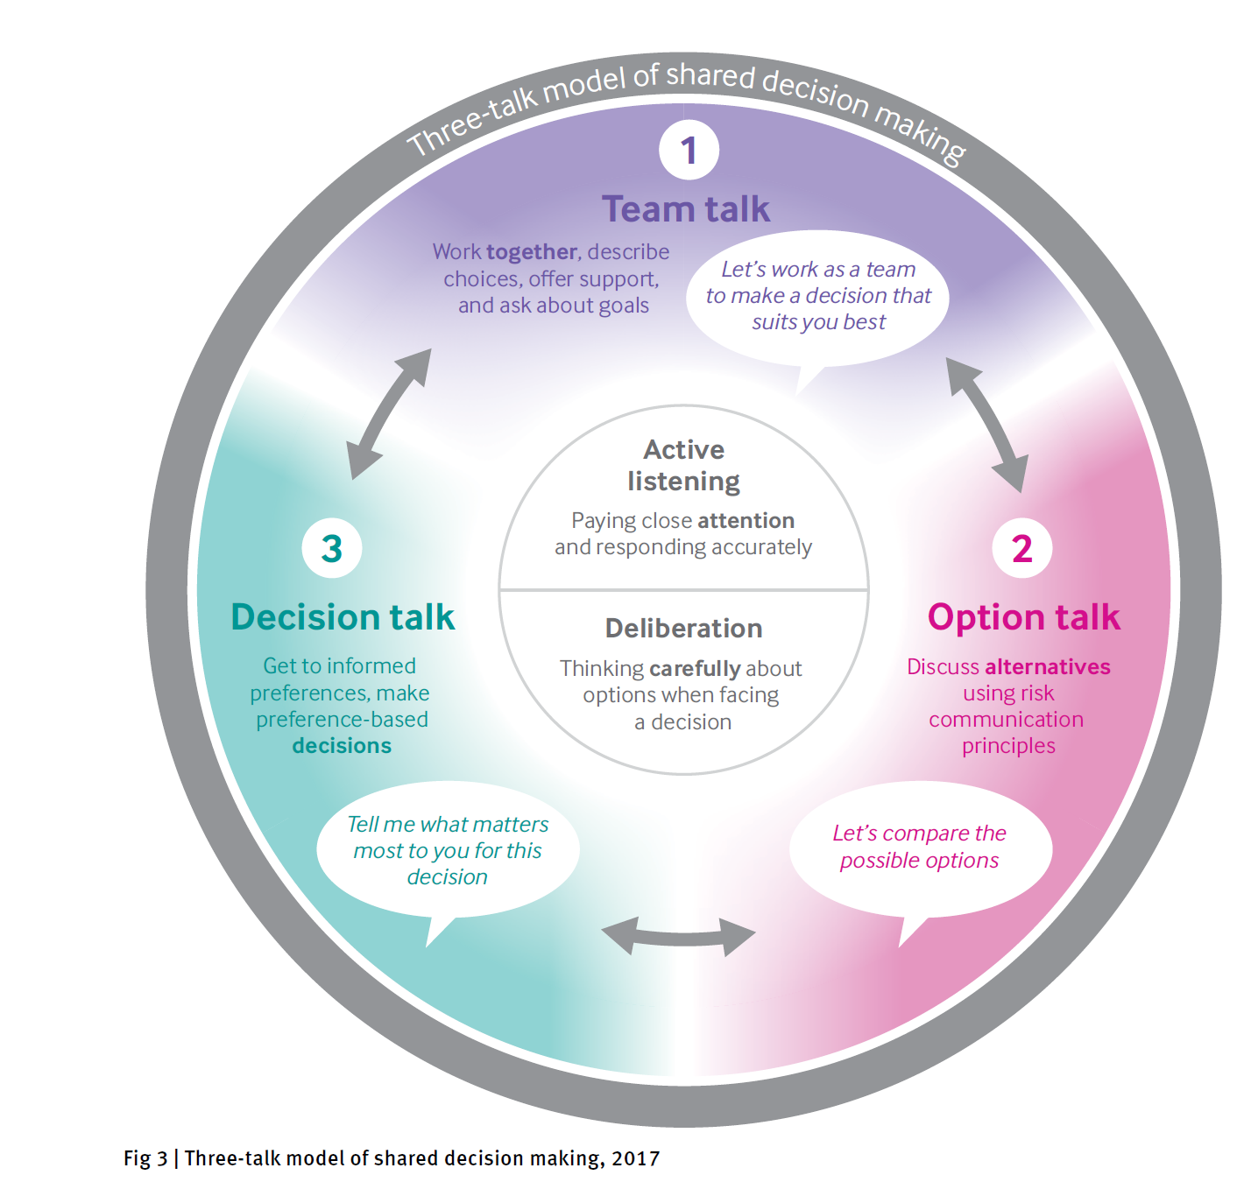
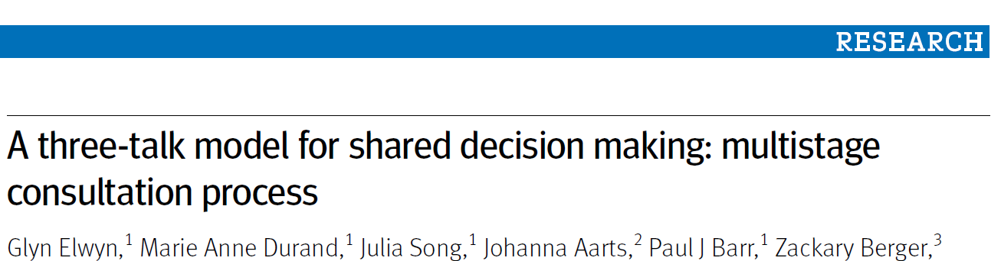
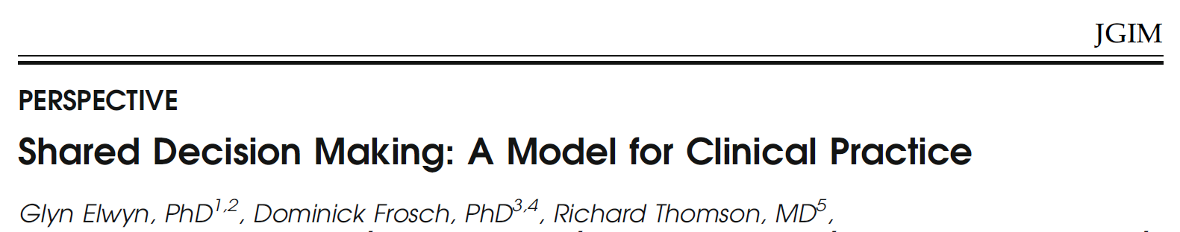
Comprehensive Futility Judgement
doi: 10.1136/bmj.j4891 | BMJ 2017;359:j4891
PATIENTS (and relatives)
ENGAGEMENT
J Gen Intern Med 27(10):1361–7, 2012
Notes:
Seems working

Slide 12
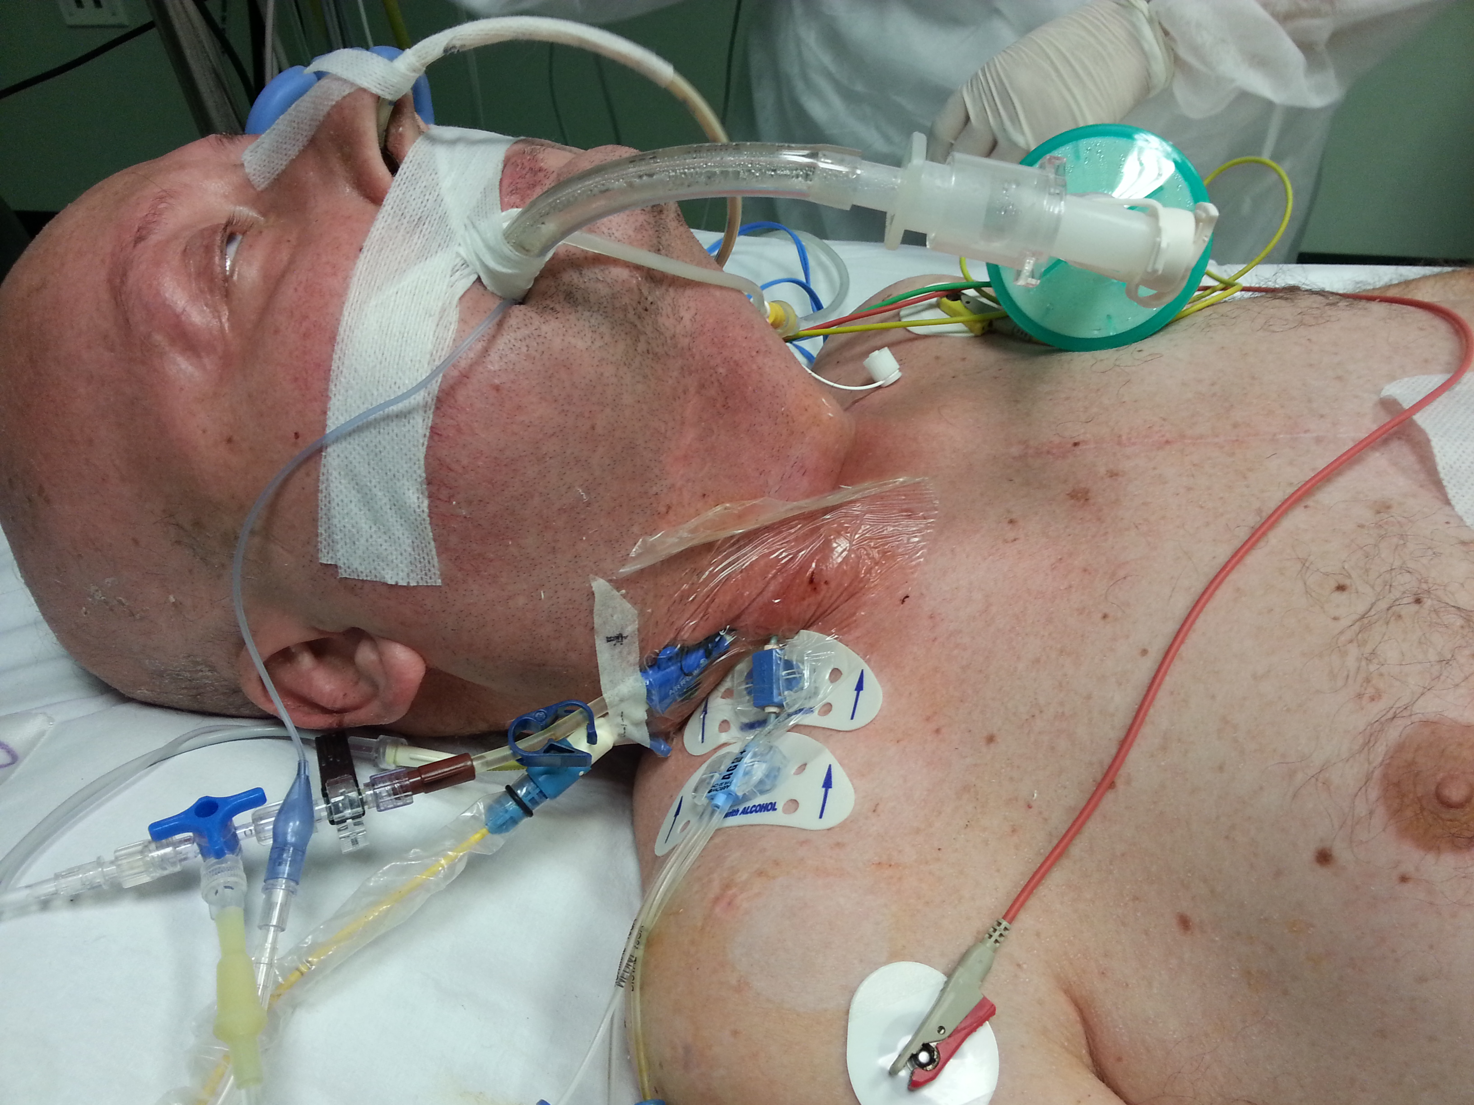
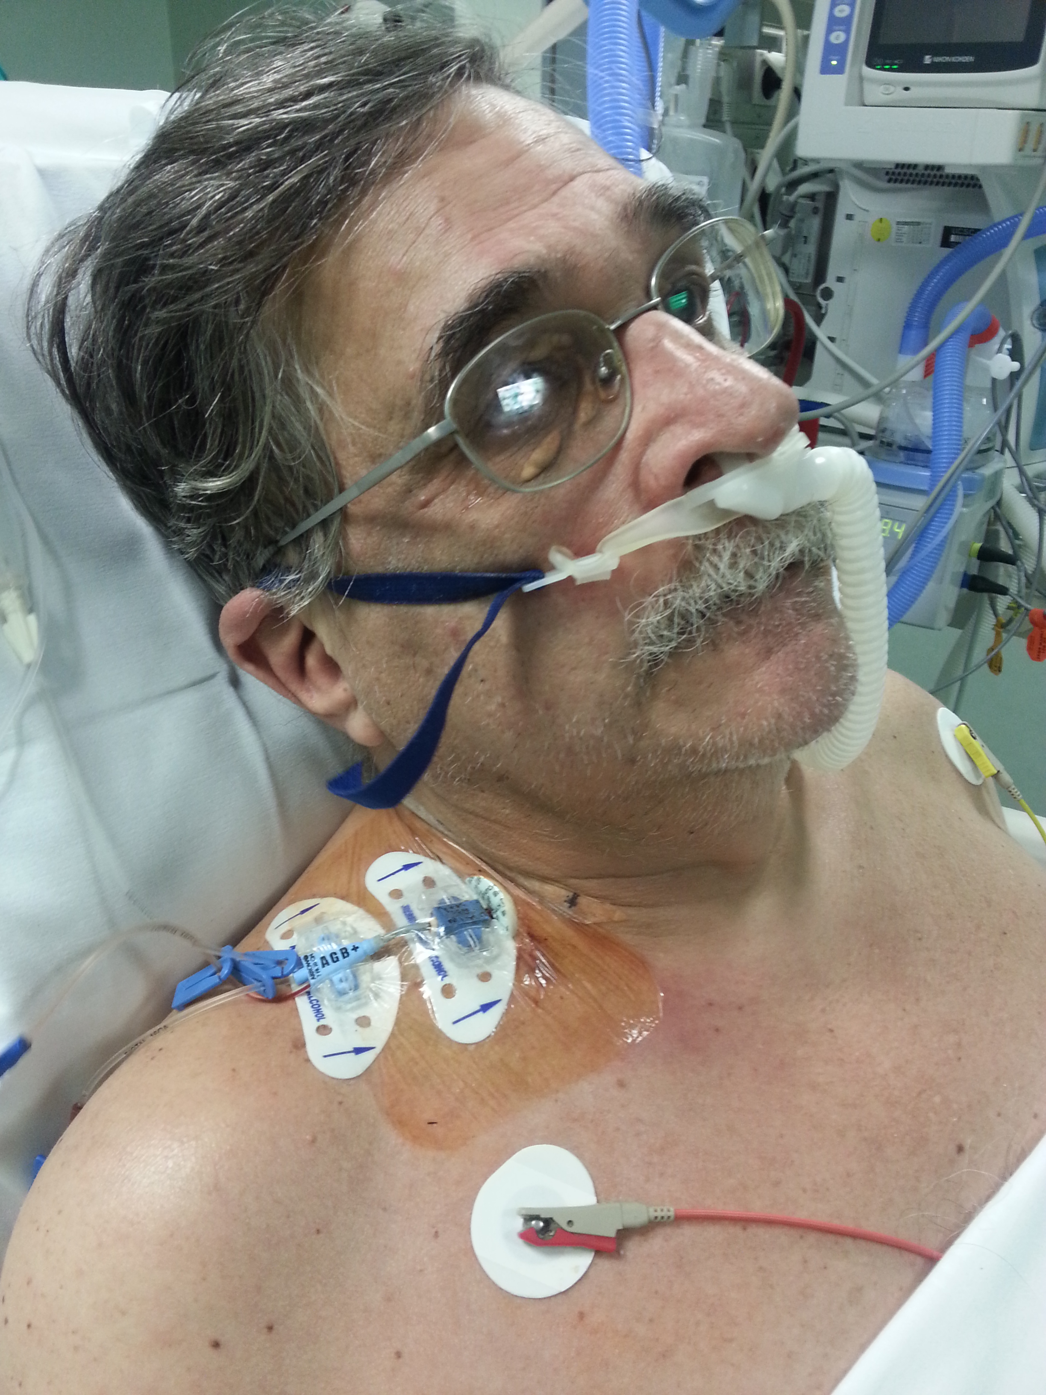
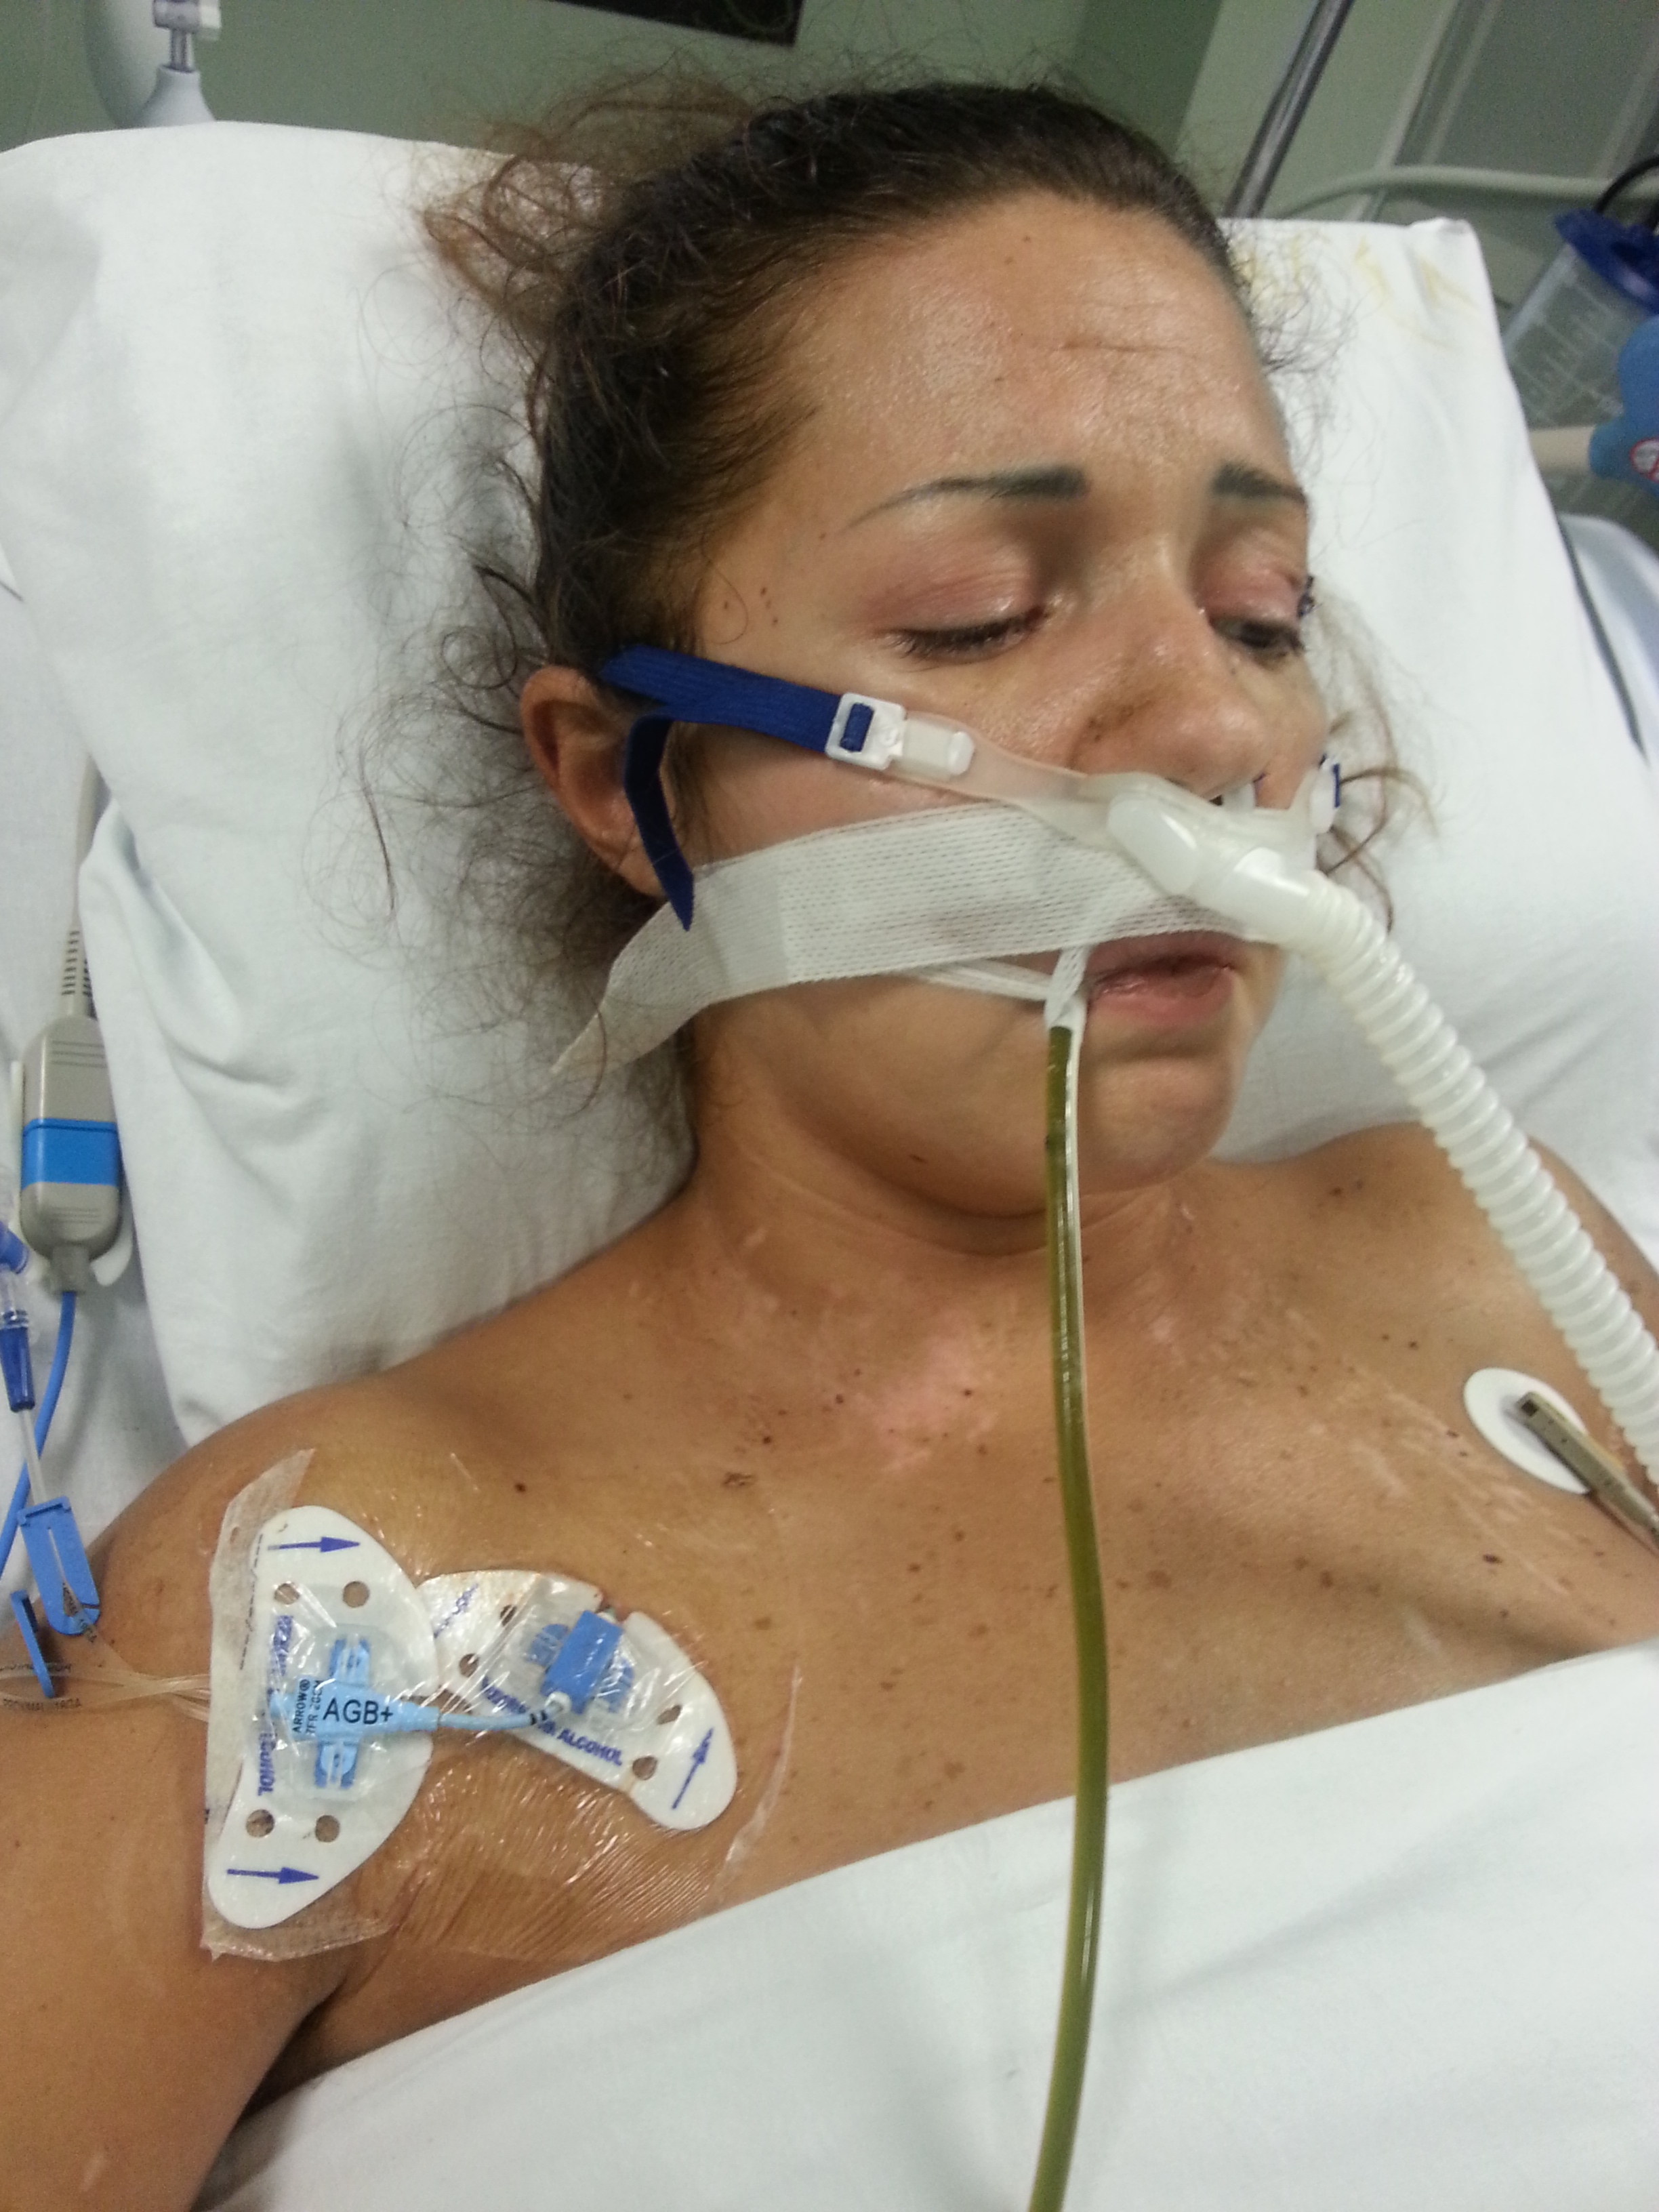
Futility «Quantification»: does it work?
What about patients engagement in emergency?
And what if
no advanced healthcare directives available?
Notes:
Unfortunately most of our potentially «futile» patients cannot be engaged …

Slide 13
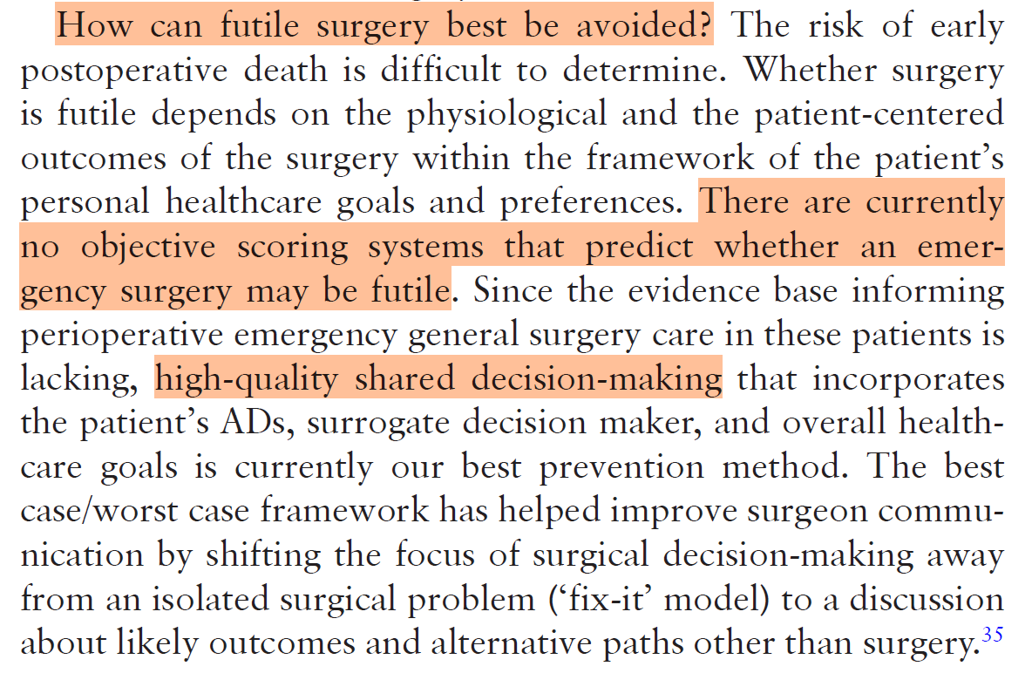
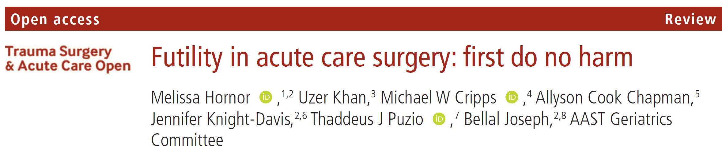
Comprehensive Futility Judgement
AN
«ACS FUTILITY TEAM»?

Slide 14
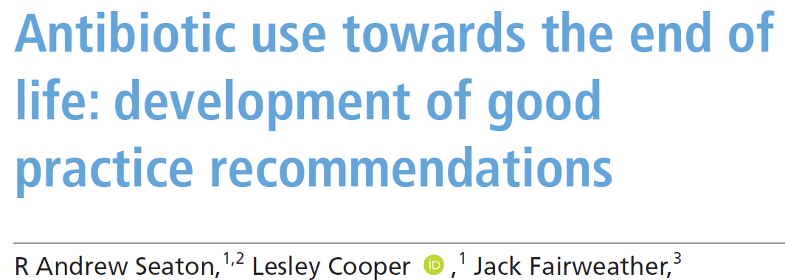
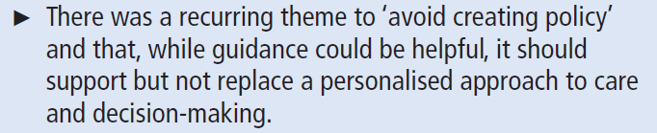
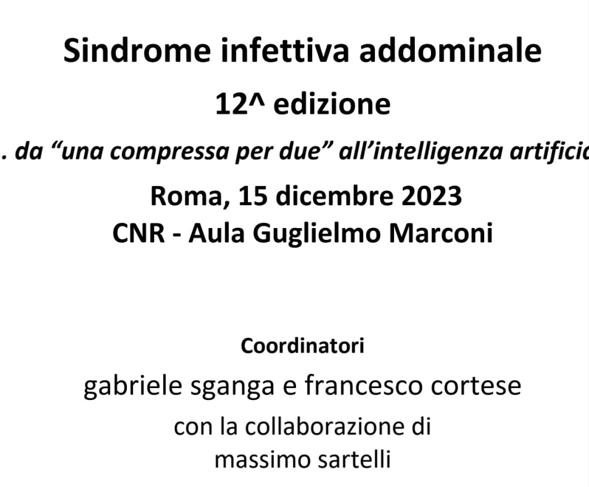
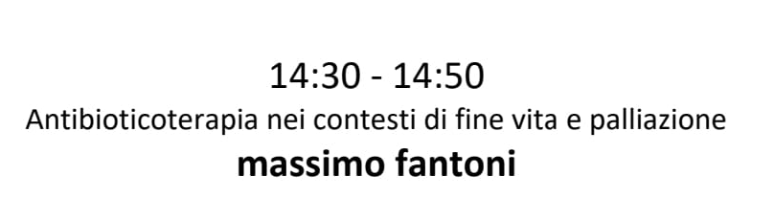

Slide 15
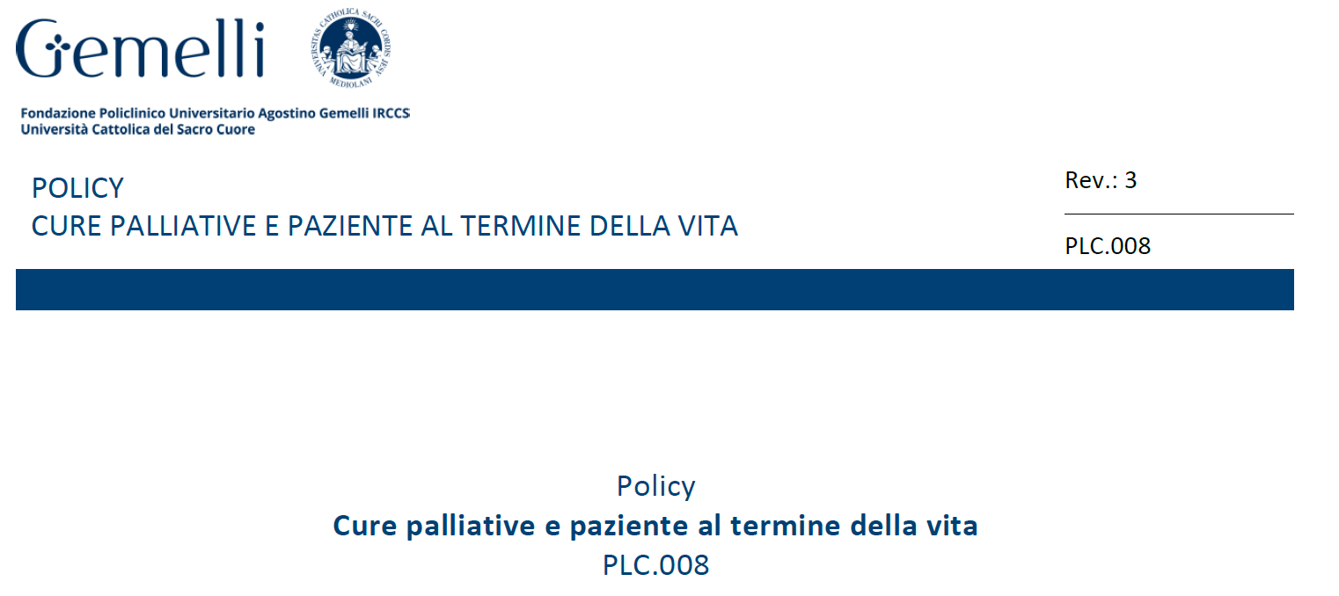

Slide 16
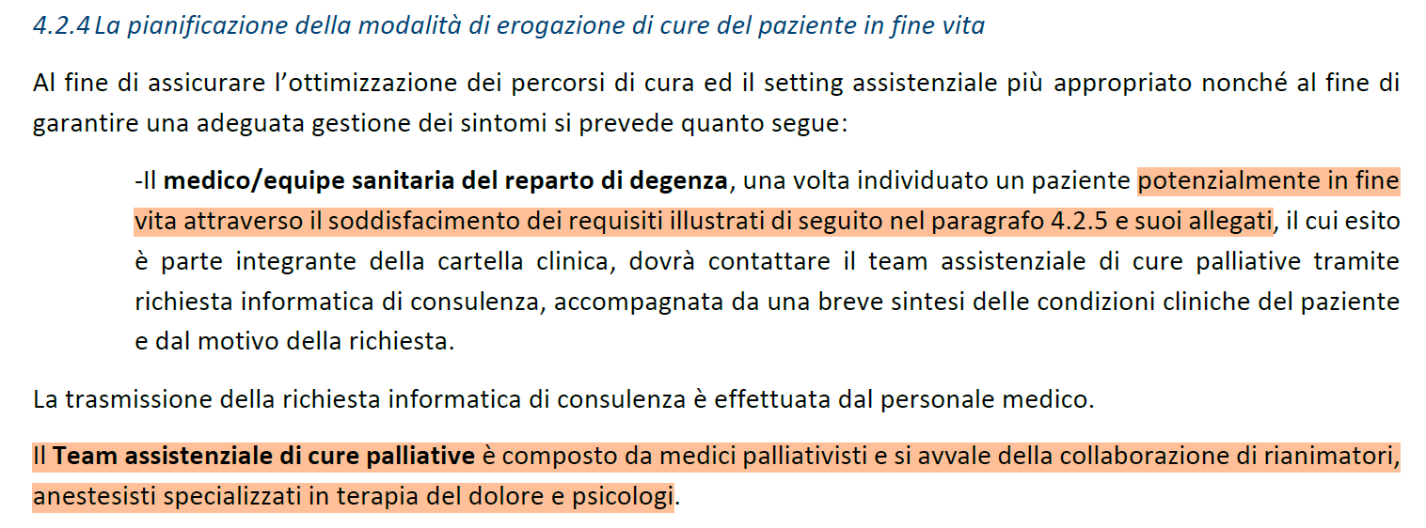

Slide 17
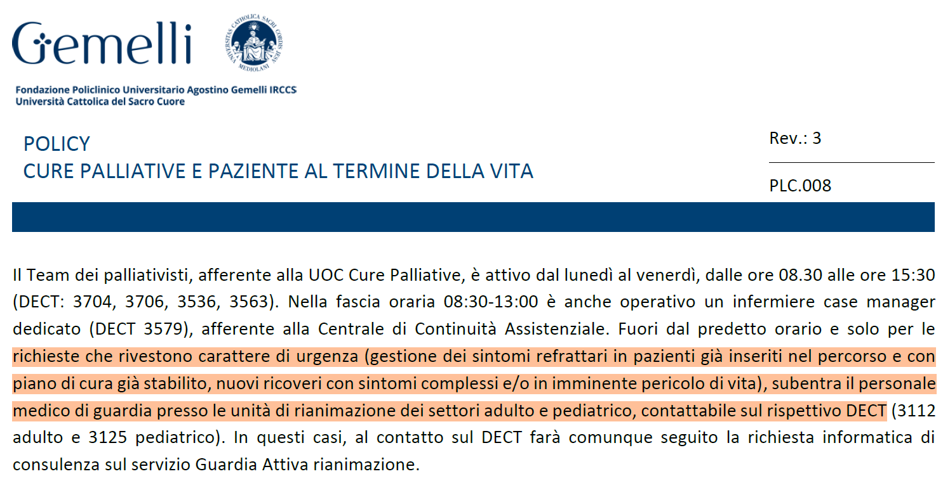

Slide 18
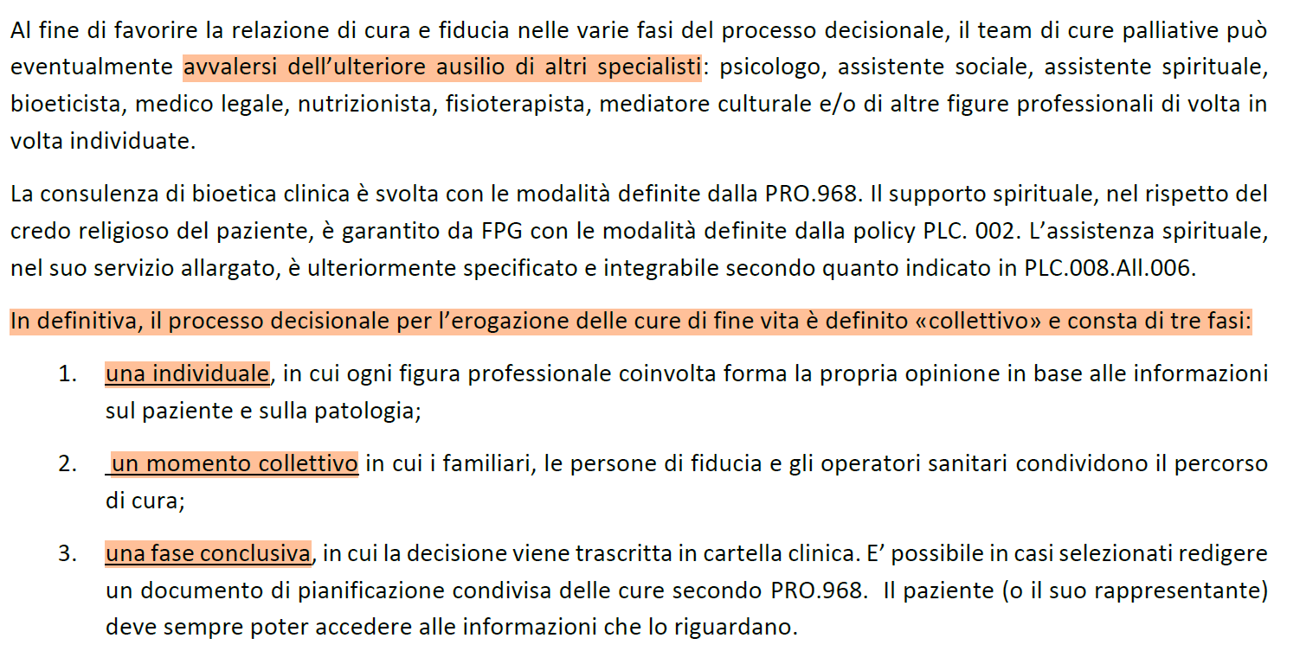

Slide 19
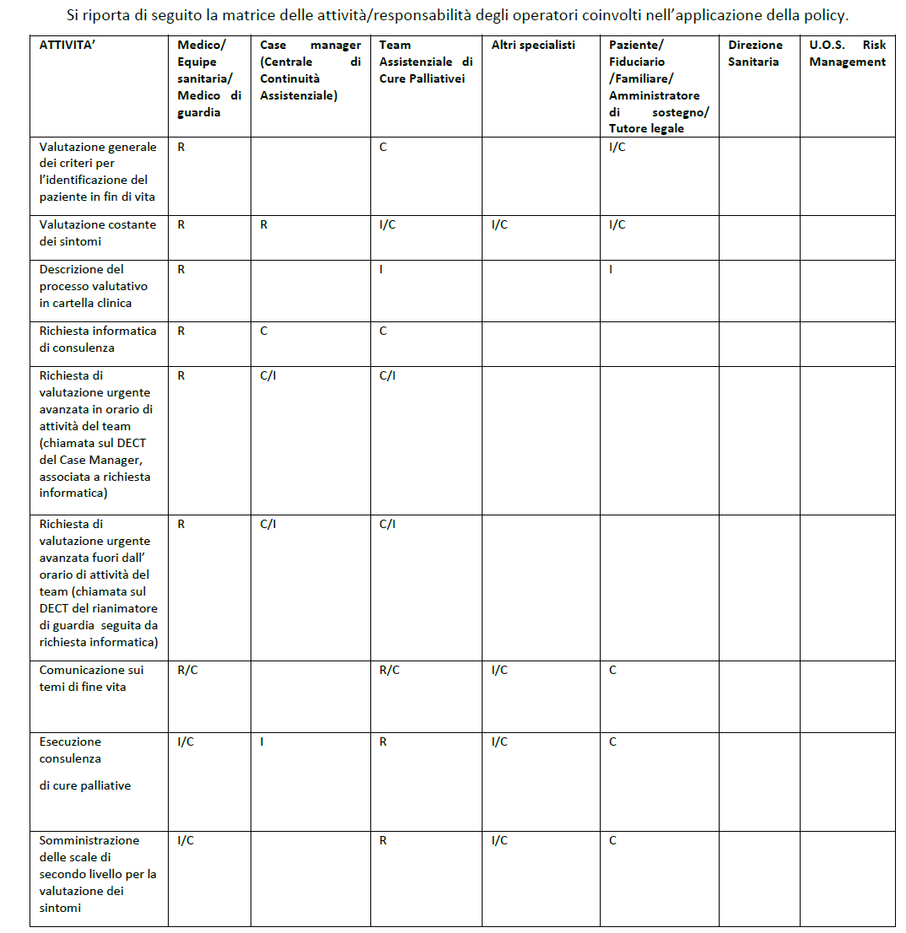
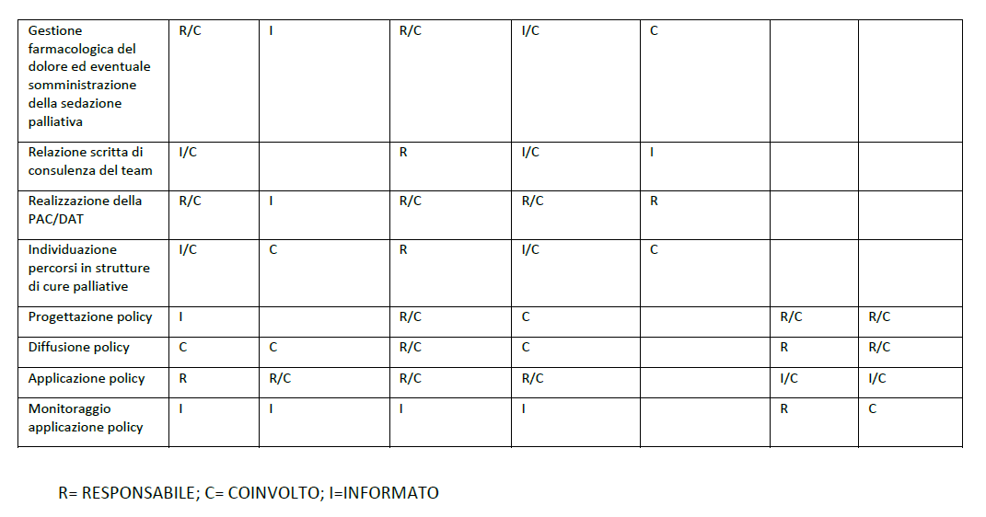

Slide 20
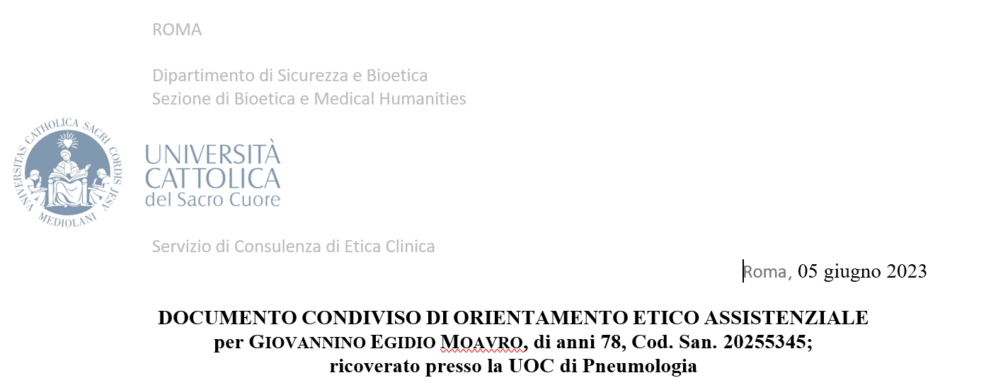
Comprehensive Futility Judgement
AN «ACS FUTILITY TEAM»
CORE
- ACS Surgeon
- Intensivist
- Palliativist
- Nurse
SPECIALIST ON DEMAND
- Bioethicist
- Oncologist
- Cardiologist
- Pneumologist
- …

Slide 21
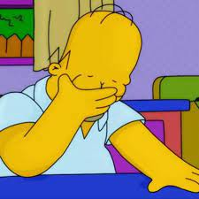
Comprehensive Futility Judgement
Finally...NOT to treat
Day 15
treatment options disproportionate
Day 21 Death

Slide 22
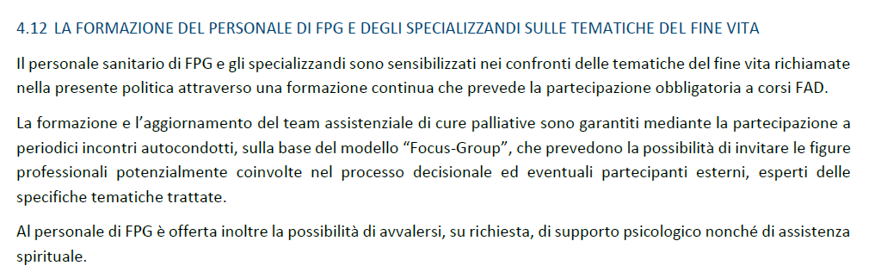
Comprehensive Futility Judgement
TRAINING ?

Slide 23
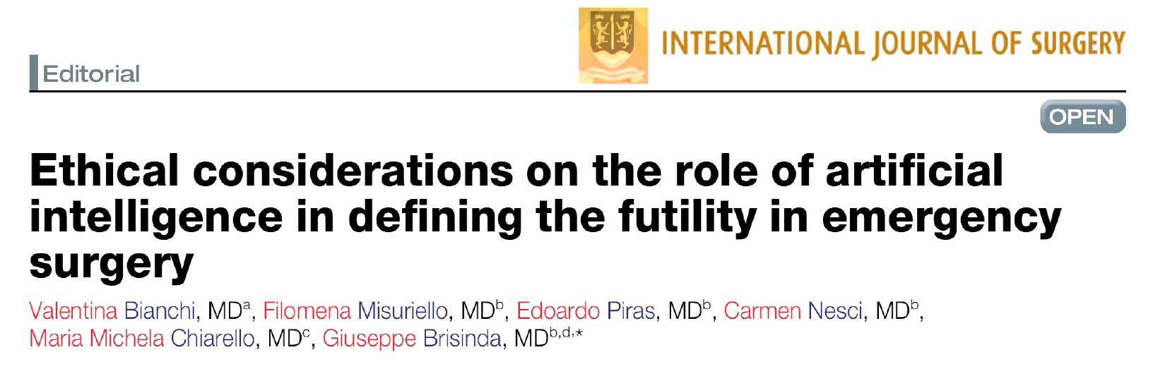
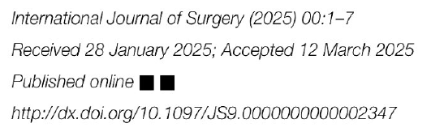
Comprehensive Futility Judgement
FURTHER DEVELOPMENTS

Slide 24

CONCLUSIONS
No standards available for futility judgement
Presently, only multidisciplinary team working can relieve this hard job both for patients and relatives as well as for operators
Policies are recommended, but still human judgement is the cornerstone
Training in this field is simply non-existent
«the amateur pilot is surprised if one of the instruments fails, but the professional is surprised if they work»
Old aviation saying

Slide 25

THANKS
antonio.lagreca@policlinicogemelli.it
antonio.lagreca@unicatt.it

